Slide 1
Parsing II : Top-down Parsing
Lecture 7
CS 4318/5531 Spring 2010
Apan Qasem
Texas State University
*some slides adopted from Cooper and Torczon

Slide 2
Review
Parsing Goals
Context-free grammars
Derivations
  Sequence of production rules leading to a sentence
    Leftmost derivations
    Rightmost derivations
Parse Trees
  Tree representation of a derivation
  Transforms into IR
Precedence in languages
  Can manipulate grammar to enforce precedence
  Cannot do this with REs
Notes:
Are there cases where we have a rightmost derivation but not a leftmost one, or vice versa?

Slide 3

Chomsky Hierarchy
DFA/NFA
RL
PDA
Many parsers
LL(1)
LR(1)
CFL
CSL
Unrestricted
Turing machines
Recursively enumerable
Noam Chomsky
Three Models for the Description of Language, 1956

Slide 4
Today
Top-down parsing algorithm
Issues in parsing
  Ambiguity
  Backtracking
  Left Recursion

Slide 5
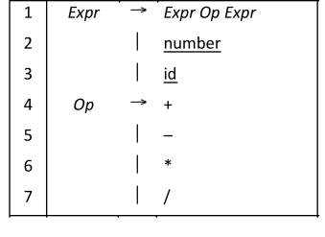
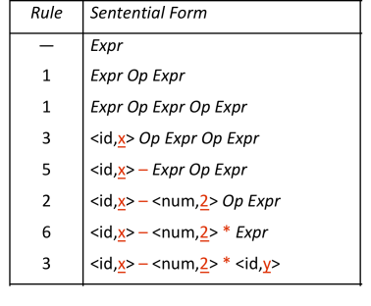
Another Derivation for x – 2 * y
Can we categorize this as leftmost or rightmost derivation?

Slide 6
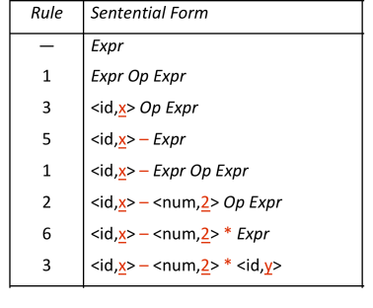
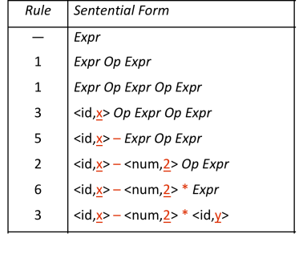
Two Leftmost Derivations for x – 2 * y
Original choice
New choice
Is this a problem for parsers?
  implies non-determinism, difficult to automate

Slide 7
Ambiguous Grammar
If a grammar has more than one leftmost derivation for a single sentential form, the grammar is ambiguous
If a grammar has more than one rightmost derivation for a single sentential form, the grammar is ambiguous
The leftmost and rightmost derivations for a sentential form may differ, even in an unambiguous grammar

Slide 8
Ambiguity Example : The Dangling else
Classic example
Stmt → if Expr then Stmt
  | if Expr then Stmt else Stmt
  | … other stmts …

Slide 9
Ambiguity Example : Derivation
Input: if E1 then if E2 then S1 else S2
First derivation
    stmt
    2 if expr then stmt else stmt
    1 if expr then if expr then stmt else stmt
    if E1 then if E2 then S1 else S2
Second derivation
    stmt
    1 if expr then stmt
    2 if expr then if expr then stmt else stmt
    if E1 then if E2 then S1 else S2

Slide 10
Ambiguity Example : Parse Trees
Input: if E1 then if E2 then S1 else S2
if
if
E₁
then
else
E₁
then
if
S₂
if
E₂
then
E₂
then
else
S₁
S₁
S₂
production 2, then production 1
production 1, then production 2

Slide 11
Resolving The Dangling Else Problem
Match else to the innermost unmatched if
      Stmt → if Expr then Stmt
        | if Expr then WithElse else Stmt
        | … other stmts …
      WithElse → if Expr then WithElse else WithElse
        | … other stmts …
Once into WithElse we cannot generate an unmatched else

Slide 12
Deeper Ambiguity
Ambiguity usually refers to confusion in the CFG
Overloading can create deeper ambiguity
  a = f(17)
The above code is fine in C but in Fortran it’s ambiguous
  f could be either a function or a subscripted variable
Disambiguating this one requires context
  Need values of declarations
  Really an issue of type, not context-free syntax
  Requires an extra-grammatical solution (not in CFG)
  Must handle these with a different mechanism
    Step outside grammar rather than use a more complex grammar

Slide 13
Dealing with Ambiguity
Ambiguity arises from two distinct sources
  Confusion in the context-free syntax (if-then-else)
  Confusion that requires context to resolve (overloading)
Resolving ambiguity
  To remove context-free ambiguity, rewrite the grammar
  To handle context-sensitive ambiguity takes cooperation
    Knowledge of declarations, types, …
    Accept a superset of L(G) & check it by other means
    This is a language design problem
In practice, most compilers will accept an ambiguous grammar
    Parsing techniques that “do the right thing”
    i.e., always select the same derivation

Slide 14
Detecting Ambiguity
Can we come up with a rule for detecting ambiguity in CFGs?
Let α be a string in the L(G)
Need to show
A ⇒* β₁ ⇒* α
and
B ⇒* β₂ ⇒* α
Turns out this is undecidable!

Slide 15
Parsing Goal
Is there a derivation that produces a string of terminals that matches the input string?
Answer this question by attempting to build a parse tree

Slide 16
Two Approaches to Parsing
Top-down parsers (LL(1), recursive descent)
Start at the root of the parse tree and grow toward leaves
At each step pick a re-write rule to apply
When the sentential form consists of only terminals check if it matches the input
Bottom-up parsers (LR(1))
Start at the leaves and grow toward root
At each step consume input string and find a matching rule to create parent node in parse tree
When a node with the start symbol is created we are done
Very high-level sketch,
Lots of holes
Plug-in the holes as we go along

Slide 17
Top-down Parsing Algorithm
Construct the root node of the parse tree with the start symbol
Repeat until input string matches fringe
    Pick a re-write rule to apply
Start symbol
  Also called goal symbol (comes from bottom-up parsing)
Fringe
  Leaf nodes from left to right (order is important)
  At any stage of the construction they can be labeled with both terminals and non-terminals

Slide 18
Top-down Parsing Algorithm
Construct the root node of the parse tree with the start symbol
Repeat until input string matches fringe
    Pick a re-write rule to apply
Need to expand on this step

Slide 19
Top-down Parsing Algorithm
Construct the root node of the parse tree with the start symbol
Repeat
    Pick the leftmost node on the fringe labeled with an NT to expand
    If the expansion adds a terminal to the leftmost node of the fringe match the terminal with input symbol and if there is a match move the cursor on the input string
Until fringe consists of only terminals
What type of derivation are we doing?

Slide 20
Selecting The Right Rules
What re-write rule do we pick?
  Can specify leftmost or rightmost NT
      Sentential Form: a B C d b A
      a B C d b A (Leftmost : Pick B to re-write)
      A B C d b A (Rightmost : Pick A to re-write)
  Solves one problem : which NT to re-write
  But we can still have multiple options for each NT
      B -> a | b | c
  Grammar does not need to be ambiguous for this to happen
  Different derivations may lead to different strings in (or not in) the language
What happens if we pick the wrong re-write rule?

Slide 21
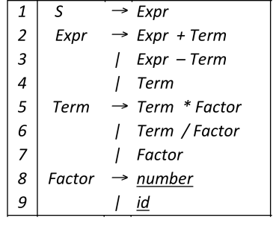
Back to the Expression Grammar
Add the start symbol
Enforce arithmetic precedence

Slide 22
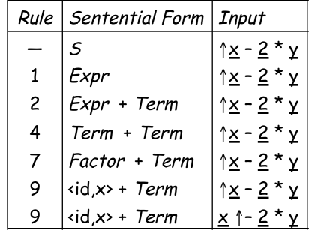
Example : Problematic Parse of x – 2 * y
S
Expr
Expr
+
Term
Term
Fact.
<id,x>
Leftmost derivation, choose productions in an order that exposes problems

Slide 23
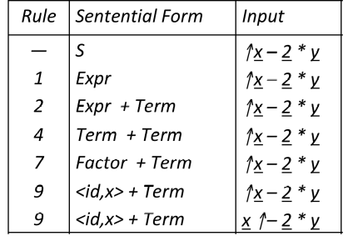
Example : Problematic Parse of x – 2 * y
S
Expr
Expr
+
Term
Term
Fact.
<id,x>
Followed legal production rules but “–” doesn’t match “+”
The parser must backtrack to the second re-write applied

Slide 24
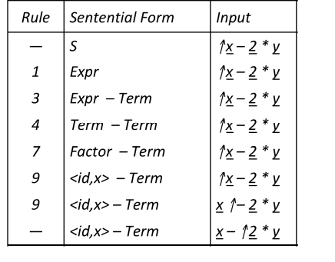
Example : Problematic Parse of x – 2 * y
S
Expr
Expr
–
Term
Term
Fact.
<id,x>

Slide 25
Example : Problematic Parse of x – 2 * y
S
Expr
Expr
–
Term
Term
Fact.
<id,x>
This time, “–” and “–” matched
We can advance past “–” to look at “2”
Now, we need to expand Term - the last NT on the fringe

Slide 26
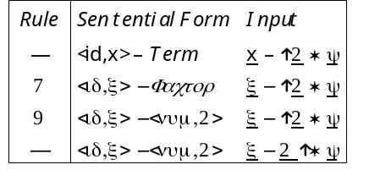
Example : Problematic Parse of x – 2 * y
S
Expr
Expr
–
Term
Term
Fact.
Fact.
<num,2>
<id,x>

Slide 27
Example : Problematic Parse of x – 2 * y
S
Expr
Expr
-
Term
Term
Fact.
Fact.
<num,2>
<id,x>
Where are we? “2” matches “2”
We have more input, but no NTs left to expand
The expansion terminated too soon
  This is also a problem !

Slide 28
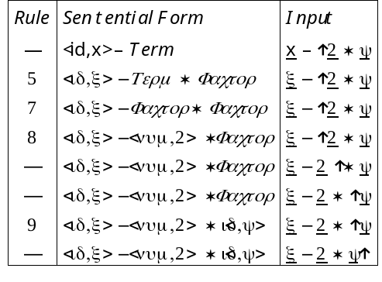
Example : Problematic Parse of x – 2 * y
S
Expr
Expr
–
Term
Term
Term
*
Fact.
Fact.
Fact.
<id,y>
<id,x>
<num,2>
This time, we matched & consumed all the input
Success!

Slide 29
Backtracking
Whenever we have multiple production rules for the same NT there is a possibility that our parser might choose the wrong one
To get around this problem most parsers will do backtracking
  If the parser realizes that there is no match, it will go back and try other options
  Only when all the options have been tried out the parser will reject an input string
  In a way, the parser is simulating all possible paths
    Does this remind you of something we have seen before?

Slide 30
Top-down Parsing Algorithm with Backtracking
Another stab at the algorithm :
Construct the root node of the parse tree with the start symbol
Repeat
  At a node labeled A, select a production with A on its lhs and for each symbol on its rhs, construct the appropriate child
  If the expansion adds a terminal to the leftmost node of the fringe attempt to match the terminal with input symbol
  if there is a match move the cursor on the input string else backtrack
  Find the next node to be expanded
Until fringe consists of only non-terminals

Slide 31
Another Possible Parse of x – 2 * y
This doesn’t terminate
Wrong choice of expansion leads to non-termination
Non-termination is a bad property for a parser to have
Parser must make the right choice
consuming no input !

Slide 32
Left Recursion
Top-down parsers cannot handle left-recursive grammars
Formally,
  A grammar is left recursive if ∃ A ∈ NT such that
  ∃ a sequence of productions A ⇒⁺ Aα, for some string α ∈ (NT ∪ T )⁺
Our expression grammar is left recursive
This can lead to non-termination in a top-down parser
For a top-down parser, any recursion must be right recursion
We would like to convert the left recursion to right recursion
Non-termination is a bad property in any part of a compiler

Slide 33
Eliminating Left Recursion
To remove left recursion, we can transform the grammar
Consider a grammar fragment of the form
  Foo → Foo α
  | β
where neither α nor β start with Foo
We can rewrite this as
  Foo → β Bar
  Bar → α Bar
  | ε
where Bar is a new non-terminal
This accepts the same language, but uses only right recursion

Slide 34
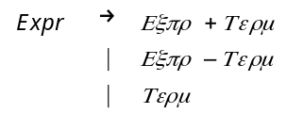
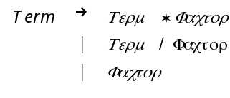
Eliminating Left Recursion
The expression grammar contains two cases of left recursion
We can eliminate both of them without changing the language

Slide 35
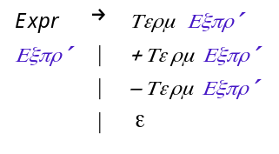
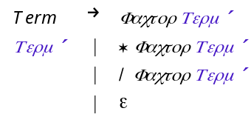
Eliminating Left Recursion
These fragments use only right recursion
They retain the original left associativity

Slide 36
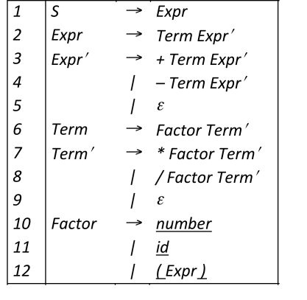
Eliminating Left Recursion
This grammar is correct, if somewhat non-intuitive.
It is left associative, as was the original
A top-down parser will terminate using it.
A top-down parser may need to backtrack with it.

Slide 37
Eliminating Left Recursion
The transformation eliminates immediate left recursion
What about more general, indirect left recursion ?
The general algorithm:
  arrange the NTs into some order A₁, A₂, …, A_{n}
  for i ← 1 to n
  for s ← 1 to i – 1
    replace each production A_{i} → A_{s}γ with A_{i} → δ₁γ ⏐δ₂γ⏐…⏐δ_{k}γ,
    where A_{s} → δ₁⏐δ₂⏐…⏐δ_{k} are all the current productions for A_{s}
    eliminate any immediate left recursion on A_{i}
    using the direct transformation
This assumes that the initial grammar
has no cycles (A_{i} ⇒⁺ A_{i} )
no epsilon productions

Slide 38
Eliminating Left Recursion
How does this algorithm work?
  Impose arbitrary order on the non-terminals
  Outer loop cycles through NT in order
  Inner loop ensures that a production expanding A_{i} has no non-terminal A_{s} in its rhs, for s < I
  Last step in outer loop converts any direct recursion on A_{i} to right recursion using the transformation shown earlier
  New non-terminals are added at the end of the order and have no left recursion
At the start of the i^{th} outer loop iteration
  For all k < i, no production that expands A_{k} contains a non-terminal A_{s} in its rhs, for s < k

Slide 39
Example : Eliminating Left Recursion
Order of symbols: G, E, T
G  E
E  E + T
E  T
T  E - T
T  id

Slide 40
Example : Eliminating Left Recursion
Order of symbols: G, E, T
1. A_{i} = G
G  E
E  E + T
E  T
T  E - T
T  id

Slide 41
Example : Eliminating Left Recursion
Order of symbols: G, E, T
1. A_{i} = G
G  E
E  E + T
E  T
T  E - T
T  id
2. A_{i} = E
G  E
E  T E'
E'  + T E'
E'  e
T  E - T
T  id

Slide 42
Example : Eliminating Left Recursion
Order of symbols: G, E, T
1. A_{i} = G
G  E
E  E + T
E  T
T  E - T
T  id
2. A_{i} = E
G  E
E  T E'
E'  + T E'
E'  e
T  E - T
T  id
3. A_{i} = T, A_{s} = E
G  E
E  T E'
E'  + T E'
E'  e
T  T E' - T
T  id

Slide 43
Example : Eliminating Left Recursion
Order of symbols: G, E, T
1. A_{i} = G
G  E
E  E + T
E  T
T  E - T
T  id
2. A_{i} = E
G  E
E  T E'
E'  + T E'
E'  e
T  E - T
T  id
3. A_{i} = T, A_{s} = E
G  E
E  T E'
E'  + T E'
E'  e
T  T E' - T
T  id
4. A_{i} = T
G  E
E  T E'
E'  + T E'
E'  e
T  id T'
T'  E' - T T'
T'  e

Slide 44
Detecting Ambiguity
    A → aA
    | B
    B → bB
    | b
One leftmost derivation
A → aA → aB → ab
Another leftmost derivation
A → B → b
What does that tell us?
Nothing!
Need multiple leftmost derivation
for the same string

Slide 45
Detecting Ambiguity
    A → aA
    | B
    B → bB
    | b
    | aAb
One leftmost derivation
A → aA → aB → abB → abb
Another leftmost derivation
A → B → aAb → aBb → abb
When a prefix (containing at least one NT) of alternate rules are
identical the grammar is ambiguous
  X → αβ₁ | αβ₂

